Slide 1
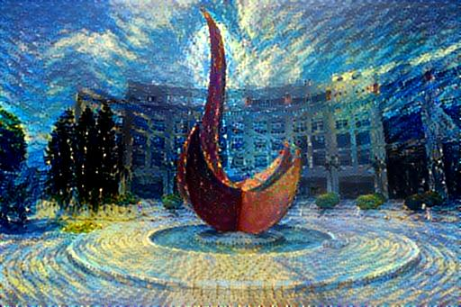
Topics on CNN: Visualization, Transfer Learning, Neural Style, and Adversarial Examples
Yuan YAO
HKUST

Slide 2
Acknowledgement
https://stats385.github.io/
http://cs231n.github.io/
A following-up course at HKUST: https://deeplearning-math.github.io/

Slide 3
Visualizing Convolutional Networks

Slide 4
Understanding intermediate neurons?

Slide 5
Visualizing CNN Features: Gradient Ascent
Gradient ascent: Generate a synthetic image that maximally activates a neuron

Slide 6
Visualizing CNN Features: Gradient Ascent

Slide 7
Visualizing CNN Features: Gradient Ascent

Slide 8
Visualizing CNN Features: Gradient Ascent

Slide 9
It’s easy to visualize early layers

Slide 10
Last layers are hard to visualize

Slide 12
Guided BP

Slide 13
Intermediate features via Guided BP

Slide 14
DeepDream: amplifying features

Slide 15
Example: DeepDream of Sky

Slide 16
More Examples

Slide 17
Python Notebooks
An interesting Pytorch Implementation of these visualizatoin methods
https://github.com/utkuozbulak/pytorch-cnn-visualizations
Some examples demo:
https://github.com/aifin-hkust/aifin-hkust.github.io/blob/master/2020/notebook/vgg16-visualization.ipynb
https://github.com/aifin-hkust/aifin-hkust.github.io/blob/master/2020/notebook/vgg16-heatmap.ipynb

Slide 18
Transfer Learning: Feature Extraction and Fine Tuning

Slide 19
Transfer Learning?

Slide 22
Summary
Feature Extraction vs. Fine-Tuning:
Feature extraction usually refers to freeze the bottom (early layers) and retrain the top (last) layer
Fine-Tuning usually refers to retrain the last few layers or the whole network ninialized from pretrained parameters
They are both called transfer learning
Jupyter notebook examples with pytorch:
https://github.com/aifin-hkust/aifin-hkust.github.io/blob/master/2020/notebook/finetuning_resnet.ipynb

Slide 23
Neural Style

Slide 24
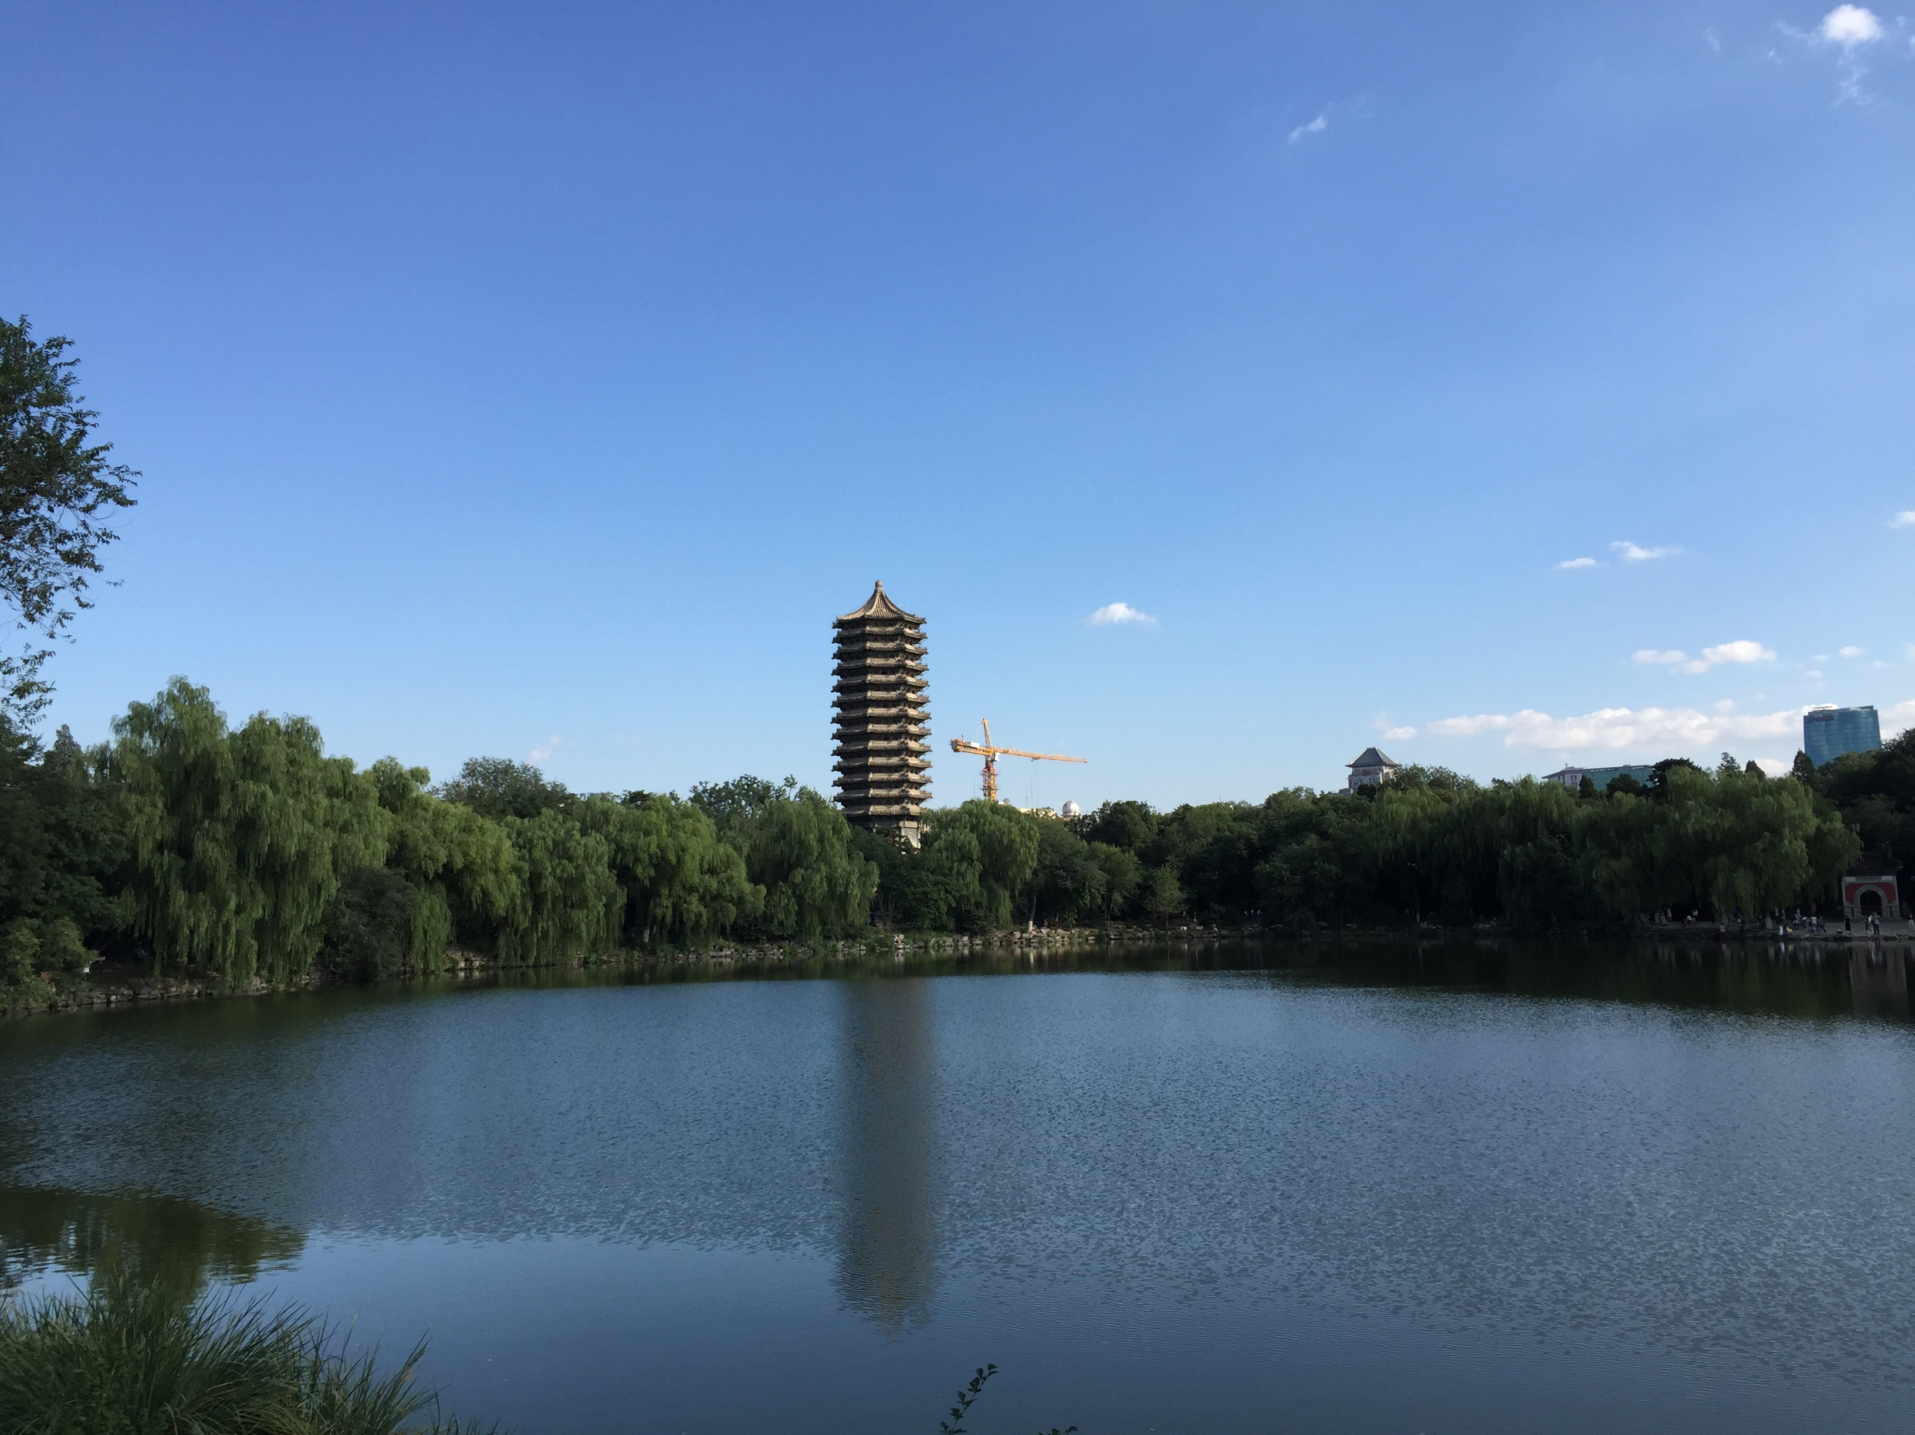
Example: The Noname Lake in PKU

Slide 25
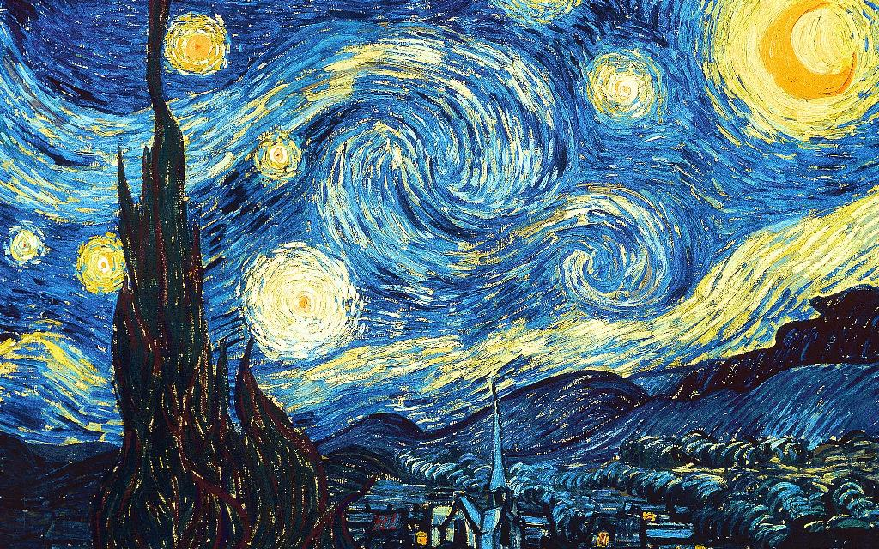
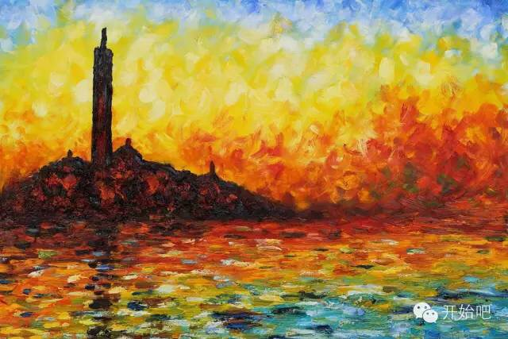
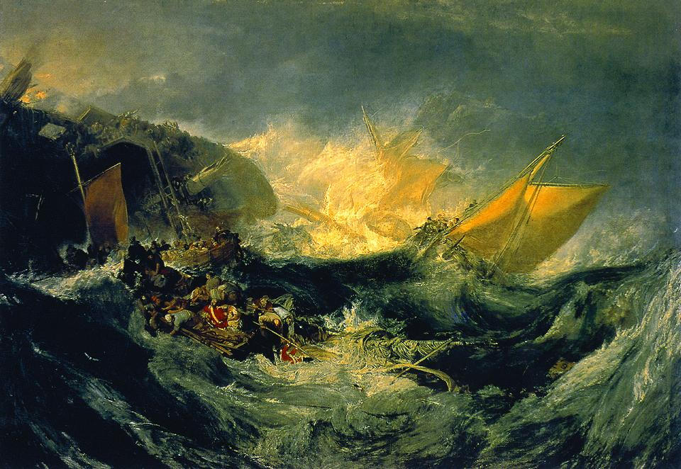
Left: Vincent Van Gogh, Starry Night
Right: Claude Monet, Twilight Venice
Bottom: William Turner, Ship Wreck

Slide 26
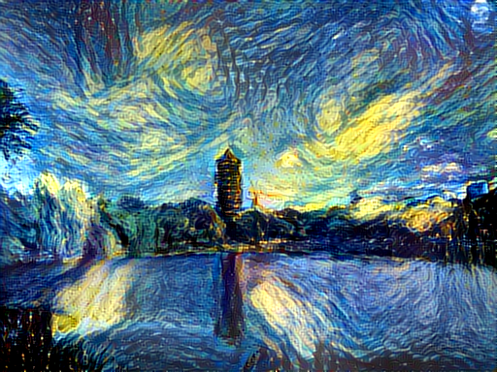
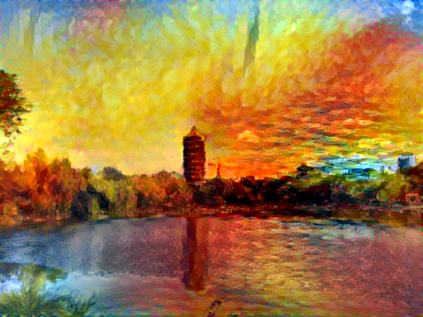
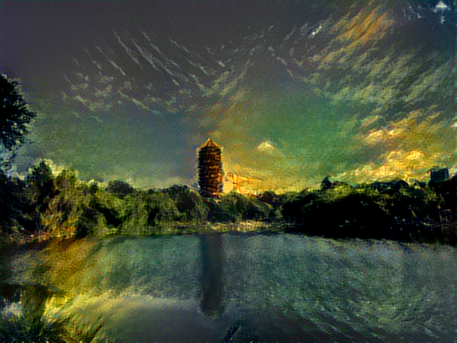
Application of Deep Learning: Content-Style synthetic pictures
By “neural-style”

Slide 27
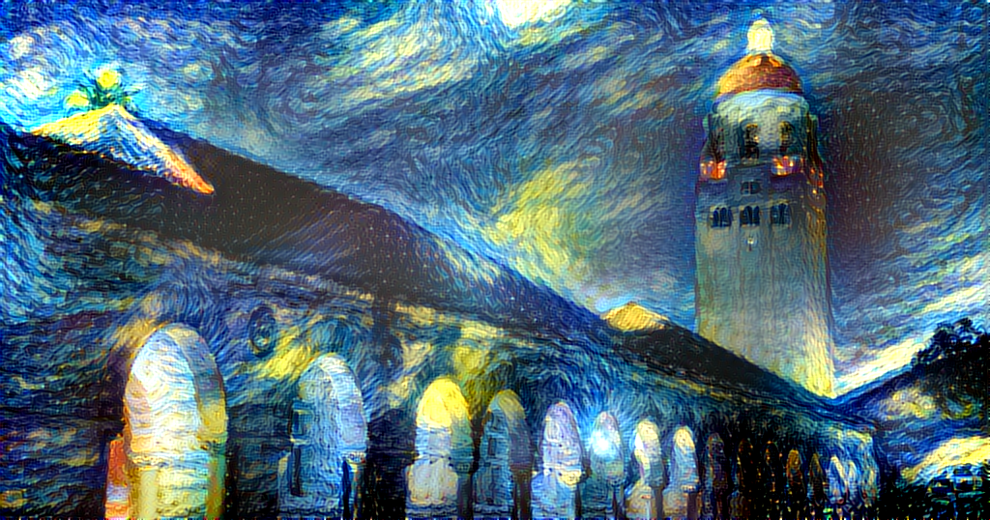
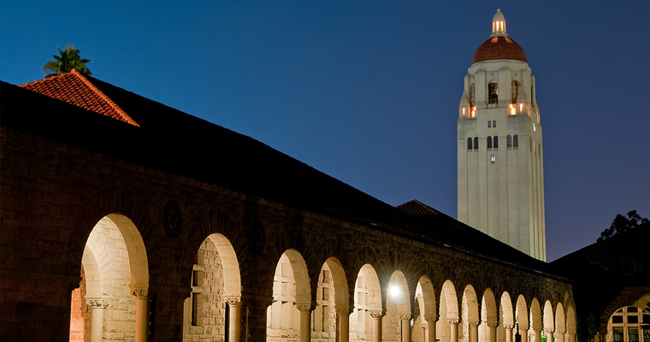


Slide 28
Neural Style
J C Johnson’s Website: https://github.com/jcjohnson/neural-style
A torch implementation of the paper
A Neural Algorithm of Artistic Style,
by Leon A. Gatys, Alexander S. Ecker, and Matthias Bethge.
http://arxiv.org/abs/1508.06576

Slide 29
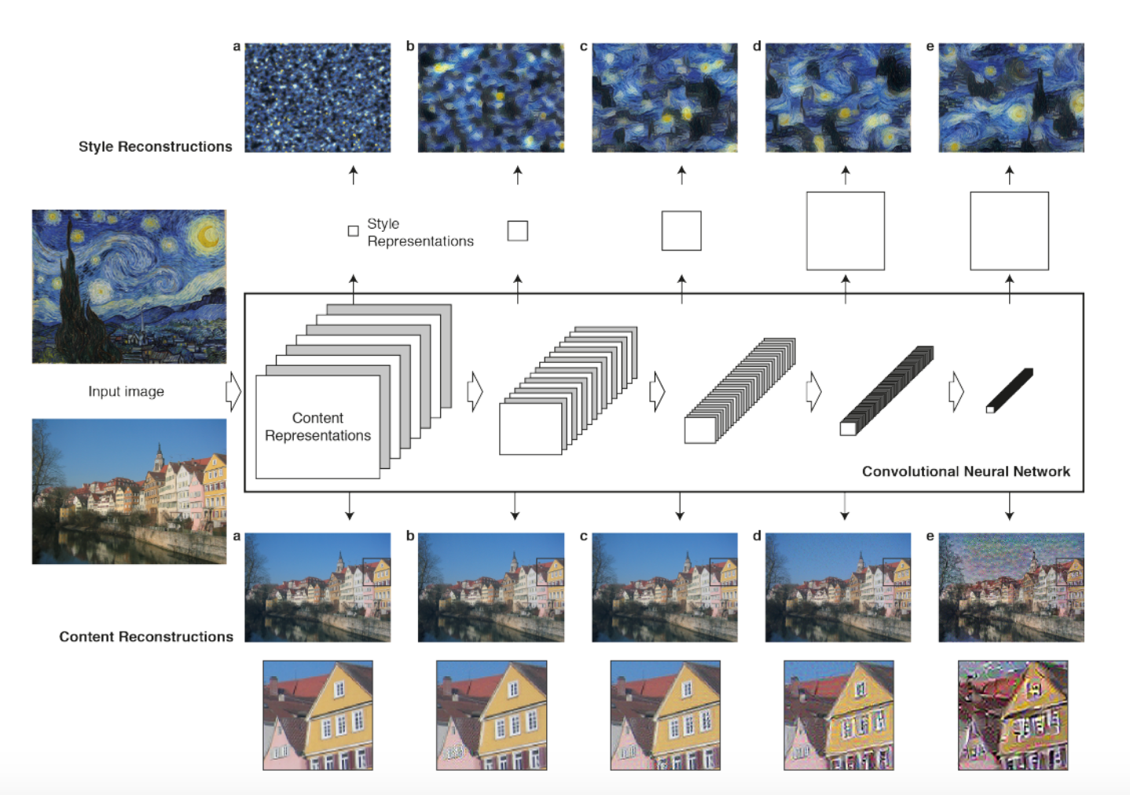
Style-Content Feature Extraction

Slide 30
Style Features as Second Order Statistics

Slide 31
Neural Texture Synthesis

Slide 34
Neural Texture Synthesis: Gram Reconstruction

Slide 35
Feature Inversion

Slide 36
Feature Inversion

Slide 38
Combined Loss for both Content (1st order statistics) and Style (2nd order statistics: Gram)

Slide 39
Neural Style Transfer

Slide 40
CNN learns texture features, not shapes!
Geirhos et al. ICLR 2019
https://videoken.com/embed/W2HvLBMhCJQ?tocitem=46
1:16:47

Slide 41
Examples
Jupyter Notebook Demo

Slide 42
Adversarial Examples and Robustness

Slide 43
Deep Learning may be fragile: adversarial examples

Slide 44
Adversarial Examples: Fooling Images
Start from an arbitrary image
Pick an arbitrary class
Modify the image to maximize the class
Repeat until network is fooled

Slide 45
Fooling Images/Adversarial Examples

Slide 46
Convolutional Networks lack Robustness
Courtesy of Dr. Hongyang ZHANG.

Slide 47
Adversarial Robust Training
Extended by Hongyang ZHANG et al. by TRADES, 2019.

Slide 48
Thank you!

